Slide 1
Introduction to Database Systems
Definition, Basic Concepts, and Introduction
By:Dr.Subhasish Mohapatra
Text Book :Korth and Navathe

Slide 2
Agenda
Definition of a Database System
Importance of Database Systems
Basic Concepts
Database System Architecture
Advantages of Database Systems
Summary

Slide 3
Definition of Database System
Database: A structured collection of data stored electronically.
Database Management System (DBMS): Software that enables users to define, create, maintain, and control access to the database.
Key Characteristics:
- Organized: Ensures data is structured systematically.
- Persistent: Data remains available over time.
- Accessible: Data can be retrieved and modified easily.

Slide 4
Why EXCEL Is Not RDBMS
Lack of Constraints: Excel does not enforce strict data validation rules like primary keys, foreign keys, or unique constraints, which are essential for maintaining data integrity.Error-Prone: Manual data entry and formulae in Excel are prone to human errors, leading to inconsistencies.
Limited Data Capacity: Excel has a maximum limit of about 1,048,576 rows and 16,384 columns per worksheet, which is inadequate for handling large datasets.
Performance Bottlenecks: As data size grows, Excel becomes slow and less responsive, especially with complex formulas or operations.

Slide 5
Contd…
Weak Security Controls: While Excel allows password protection, it is not as robust as database-level encryption or access control mechanisms.No Role-Based Access: Cannot assign specific permissions to different users for data access or modification.
Limited Backup Options: Databases typically have robust backup and recovery mechanisms, which Excel lacks.

Slide 6
Importance of Database Systems
Efficient data management: Stores and organizes large amounts of data.
Easy data retrieval: Quick and flexible query mechanisms.
Ensures data consistency and integrity: Avoids conflicting or duplicated data.
Supports concurrent access: Allows multiple users to interact with the database simultaneously.
Scalable and secure: Adapts to growing data needs while safeguarding information.

Slide 7
Importance of Database Systems
Efficient data management: Stores and organizes large amounts of data.
Easy data retrieval: Quick and flexible query mechanisms.
Ensures data consistency and integrity: Avoids conflicting or duplicated data.
Supports concurrent access: Allows multiple users to interact with the database simultaneously.
Scalable and secure: Adapts to growing data needs while safeguarding information.

Slide 8
Advantages of Database Systems
Reduces Redundancy: Minimizes duplication of data by centralized management.
Maintains Data Integrity: Ensures data accuracy and consistency across the system.
Ensures Security: Implements access controls to protect sensitive data.
Enables Multi-user Support: Allows simultaneous access by multiple users without conflicts.
Robust Backup and Recovery: Safeguards data in case of system failures.

Slide 9
Construction of Database Systems
Requirements Specification
Conceptual Design / Semantic Modeling
Logical Design
(DBMS Specified)
Physical Design
(DBMS Specified)
Physical design of DBS is referred as DBE.

Slide 10
Basic Concepts of Database Systems
Data: Raw facts and figures without context.
Information: Processed data that is meaningful and useful.
Database Schema: Logical design and blueprint of the database structure (e.g., tables, fields, relationships).
Instance: Snapshot of data stored in a database at a specific moment in time.
Database Languages:
- DDL (Data Definition Language): Defines the structure of the database (e.g., CREATE, ALTER, DROP).
- DML (Data Manipulation Language): Manages data within tables (e.g., SELECT, INSERT, UPDATE, DELETE).
- DCL (Data Control Language): Controls access to the database (e.g., GRANT, REVOKE).

Slide 11
Database System Architecture
Single-tier Architecture:
Direct communication between user and database.
Example: Personal database applications.
1 tier architecture is a database management system design where all components reside on a single server or platform, enabling direct access to the database by end users.
Two-tier Architecture:
Application layer sits between user and database.
Example: Client-Server applications.
2 tier architecture is used in client-server applications where multiple users need access to the same database, offering better scalability and security than 1-tier architecture.

Slide 12
Contd..
Three-Tier Architecture
Middle-tier (application server) processes business logic and communicates with the database.
Example: Web-based applications.
3 tier architecture involves an additional layer between the client and the server. The 3 tier architecture consists of the client communicating with an application server, which then connects to the database system, maintaining isolation between the end-user and the database.

Slide 13
Three-Tier Architecture…
The three-tier model further separates the application logic into a middle tier, distinct from both the client and the database. This middle tier handles tasks such as data processing, business rules, and application workflow, leaving the client to focus solely on the user interface. This separation of concerns offers several advantages such as:
it enhances scalability, as each tier can be scaled independently based on specific needs.
it improves maintainability by allowing developers to modify one tier without significantly impacting the others.
The middle tier also acts as a buffer between the client and the database, providing an additional layer of security.

Slide 14
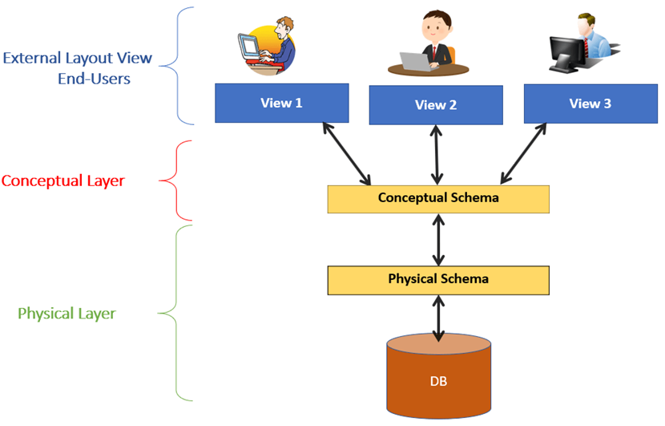
ANSI (American National Standards Institute) / SPARC (Standards Planning And Requirements Committee) Model:
View / User / External / Simple Level / View / Schema (Sub Schema)
Logical / Conceptual Level / View / Schema (Global Schema)
Internal / Physical Level / View / Schema

Slide 15
Aspect | DBMS | RDBMS
Full Form | Database Management System | Relational Database Management System
Data Model | Stores data as files | Stores data in tables (relations)
Data Relationship | No or limited relationship between data | Strong relationship using primary key & foreign key
Normalization | Not supported | Supported (reduces data redundancy)
Data Integrity | Less data integrity | High data integrity using constraints
ACID Properties | Not fully supported | Fully supports ACID properties
Multi-user Access | Limited multi-user support | Supports multiple users simultaneously
Security | Less secure | More secure with roles and permissions
Scalability | Suitable for small applications | Suitable for large and complex applications
Examples | File system, XML databases | MySQL, Oracle, SQL Server, PostgreSQL

Slide 16
Aspect | Structured | Unstructured
Schema | Fixed | No fixed schema
Data Format | Rows and columns | Text, image, video, audio
Query Language | SQL | No standard query language
Flexibility | Low | High
Storage Type | Relational DB | NoSQL / File-based
Scalability | Vertical | Horizontal
Examples | MySQL, Oracle | Hadoop, MongoDB, Elasticsearch

Slide 17
Aspect | Schema | Table
Purpose | Organizes database objects | Stores actual data
Contains | Tables, views, indexes | Rows and columns
Data Storage | No | Yes
Level | Logical structure | Physical data storage
Example | public, dbo | students, employee

Slide 18
Questions
What is external level of a three-level DBMS?
External level is the user view, which provides a customized and personalized perspective of the database. It represents the different ways in which different users access and interact with the database.
What is conceptual level of a three-level DBMS?
Conceptual level is the community view, which provides an abstract data model that represents the overall logical structure of the database. It defines the entities, relationships, and constraints of the database.
What is internal level of a three-level DBMS?
Internal level is the system view, which represents the physical storage details of the database. It defines how the data is actually stored and accessed on the storage media.
What are the three-level architecture abstractions in DBMS?
The three-level architecture abstractions in DBMS are:
Physical level
Logical level
View level
‍

Slide 19
Summary
Database systems are integral to modern computing and data management.
Centralized systems ensure consistency, efficiency, and scalability.
Foundational concepts include schema, instances, and database languages.
Architecture models (Single-tier, Two-tier, Three-tier) cater to varying application needs.

